Slide 1
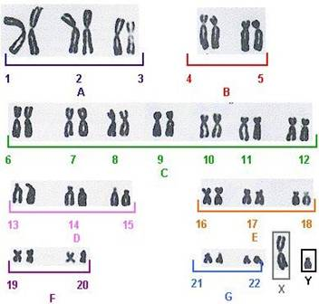
Human chromosomes
There are 46 chromosomes (23 homologous pairs) in each somatic cell
22 pairs of autosomes
1 pair of sex chromosomes
XX = Female, XY = Male
Karyotype - chromosomes are arranged according to shape and size

Slide 2
AN EXTRA COPY OF CHROMOSOME 21 CAUSES DOWN SYNDROME
This condition is called trisomy 21.
Person with this condition suffers from
the Down syndrome.
Characteristic facial features:
Round face
Flattened nose bridge
Small, irregular teeth
Short stature
Heart defects

Slide 3
Klinefelter's syndrome, 47, XXY
It is the most common sex chromosome disorder and the second most common condition caused by the presence of extra chromosomes
Symptoms:
Language impairment
Lanky, youthful build or rounded body type
Low levels of Testosterone and small testicles / Infertile

Slide 4
Turner’s Syndrome (X)
Common symptoms:
Short stature
swelling of the hands and feet
Broad chest and widely spaced nipples
Low hairline
Low-set ears
Reproductive sterility
Increased weight, obesity
Small fingernails
Characteristic facial features
Webbed neck

Slide 5
Trisomy 13, 18 and 23

Slide 6
A healthy egg or sperm cell contains 23 individual chromosomes - one to contribute to each of the 23 pairs of chromosomes needed to form a healthy, 46 chromosome cell. However, sometimes egg and sperm cells are left with 24 (or more) chromosomes. It is the joining of these egg or sperm cells that eventually cause a trisomy fetus to be formed.

Slide 7
Trisomy 18 – Edward Syndrome
Because Trisomy 18 is caused by non-disjunction, it cannot be passed on to future generations.
In addition, babies diagnosed with Edwards syndrome rarely live past 5-6 days; fetuses identified with Trisomy 18 are often miscarried or aborted.

Slide 8
How Is it Diagnosed?
Edwards' syndrome at birth may be diagnosed by the physical abnormalities characteristic to the syndrome.
In addition, physical examination of the infant may show arched type fingerprint patterns and xrays may reveal a short breast bone.
Definitive diagnosis is achieved through karyotyping, which involves drawing the baby's blood for a microscopic examination of the chromosomes.

Slide 9
How Is it Diagnosed?
Edwards' syndrome can be detected before birth. If a pregnant woman is older than 35, has a family history of genetic abnormalities, has previously conceived a child with a genetic abnormality, or has suffered earlier miscarriages, she may undergo tests to determine whether her child carries genetic abnormalities. Potential tests include maternal serum alpha-fetal protein analysis or screening, ultrasonography, amniocentesis, and chorionic villus sampliing.

Slide 10
How Is it Treated?
There is no cure for Edwards syndrome. Ninety to 95 % of all babies born with it die within a year of birth. The few infants that do survive need special treatment--ranging from muscular therapy to nervous system and skeletal corrections--for their various handicaps.

Slide 11
Patau Syndrome
Trisomy 13

Slide 12
Description
Patau syndrome - also known as trisomy 13.
Affects about 1 in 12,000 live births.
More than 80% of infants with Patau syndrome die within their first year of life.

Slide 13
Common Problems
Nervous system problems:
Mental and motor disabilities similar to that of autism
Microcephaly, or a less rounded brain resulting in more of an egg-shaped skull
Eye structure defects:
Microphthalmia, or crossed eyes (may involve one eye or both)
Cataracts
Sensory Nystagmus, or involuntart “twitching” of the eye
Optic nerve hypoplasia, or the underdevelopment of the optic nerve

Slide 14
Common Problems cont.
Muscular and skin problems:
Polydactyly, or extra fingers/toes
Low-down ears
Prominent heels and deformed feet, called ‘rocker-bottom’ feet
Strange palm patterns, commonly called the Simian line
Overlapping of the fingers over thumb
Cleft palate

Slide 15
Treatment
There is no treatment to address the condition. However, there are procedures to sustain life for a bit.
Most times, surgery is required to fix defects to allow the child to survive for as long as possible.
Since most infants with Patau syndrome die within the first year of life, special management/procedures are necessary; this is very complex and carefully laid out. Many children have trouble surviving the first few days or weeks of life due to severe neurologic and vascular problems.

Slide 16
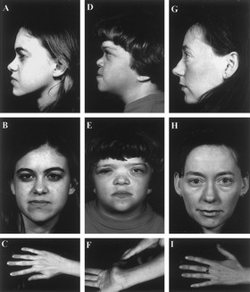
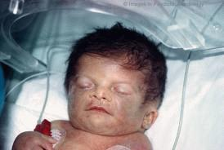
What is Triple X syndrome?
Triple X syndrome is a disability of the chromosomes that affects about 1 in 1,000 females. Females usually have one X chromosome from each parent but in Triple X syndrome, the female has 3 X chromosomes. This usually results in an error in the formation of a mother’s egg and the father’s sperm cell. Normally people have 46 chromosomes, which is 23 pairs. This condition is genetic but its not inherited.

Slide 17
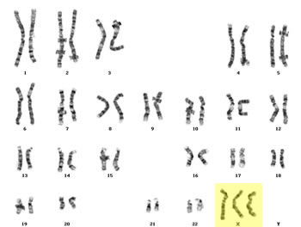

Slide 18
Symptoms
Triple X syndrome may not cause any signs or symptoms. If they do appear, it may include:
Tall stature
Small head (microcephaly)
Vertical skin folds that may cover the inner corners of your eyes
Delayed development of certain motor skills, speech and language
Learning disabilities such as dyslexia
Weak muscle tone
Seizures
Kidney abnormalities

Slide 19
Treatments
Treatment is based on your symptoms. For instance, if she has a learning disability, she would require some counseling. If your daughter has been diagnosed with Triple X syndrome, your doctor may recommend periodic screenings throughout childhood. Psychological counseling may help if your daughter is becoming stressed. The chromosome change cannot be repaired, so this syndrome has no cure. However, if you do treat your symptoms you can live life normally despite your syndrome.

Slide 20
Treatments
Treatment is based on your symptoms. For instance, if she has a learning disability, she would require some counseling. If your daughter has been diagnosed with Triple X syndrome, your doctor may recommend periodic screenings throughout childhood. Psychological counseling may help if your daughter is becoming stressed. The chromosome change cannot be repaired, so this syndrome has no cure. However, if you do treat your symptoms you can live life normally despite your syndrome.

