Slide 1
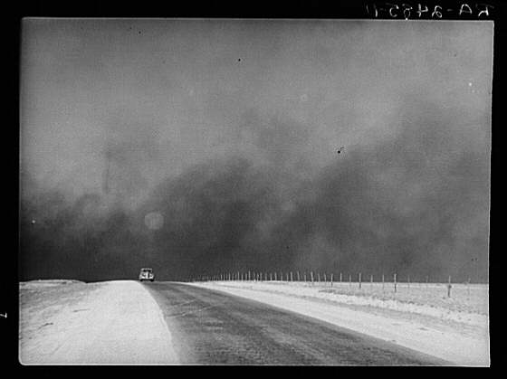
The Great Depression and the New Deal 1929-1939
http://www.youtube.com/watch?v=gplaqa2yRgg

Slide 2
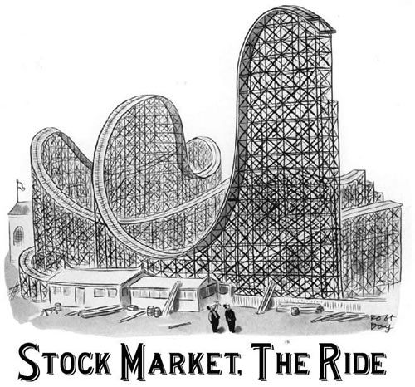
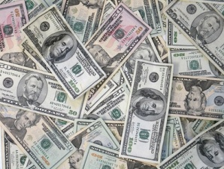
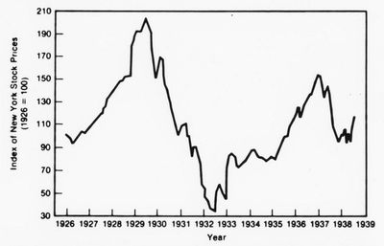
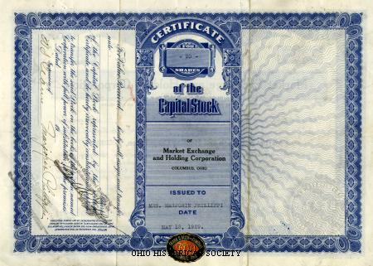

Stock market
Bull market 1920’s----Dow Jones 1924=180, 1929=381 1932=41
Buying on Margin…..5%
Banks and businesses financed brokers who facilitated risky buys
Over speculation
The Great Crash Oct 29, 1929 Black Tuesday—2 week period lost $30 Billion- $350 billion in today’s money
Took 35 years(1964)….to get back to pre 1929 level.

Slide 3
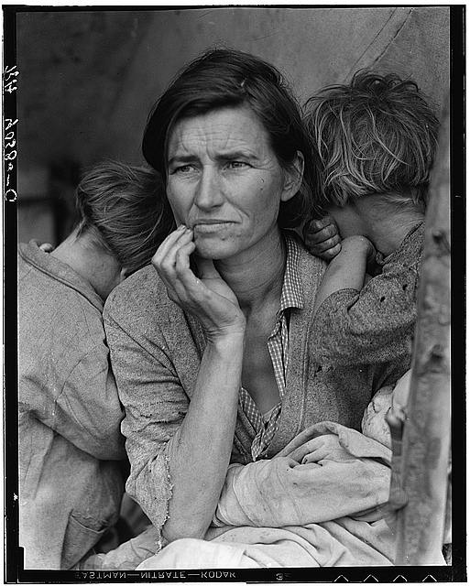
Your Grandparents generation
Effects of the Great Depression
Insecure about their financial future-hide $
“Can it happen again”
Fear of failure
“We were to blame”
Frugal with money- with things too
Importance of saving
Mistrust of “stock market boys” and mistrust of banks

Slide 4
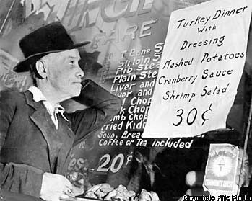
“Pot of Gold at the End of the Rainbow” Causes
Causes; economy built on a house of sand
Weak industries -Cotton, RR’s, Food
Over productions of goods-lacked middle class to consume
Uneven distribution of income top 1% owned 75%, bottom 93% owned 6%
Profits up, wages down
Weak international economy Hawley Smoot Tariff – 50%(1930) highest tariff in history, 23 nations retaliated
Home Sale and car sales decline
Stock market chain reaction margin buying and little regulation
Banking industry messed up 1% owned 46% of money
Mechanization
Poor economic knowledge(Hoover) -Tariffs, Interest rates, taxes, Trickle Down

Slide 5
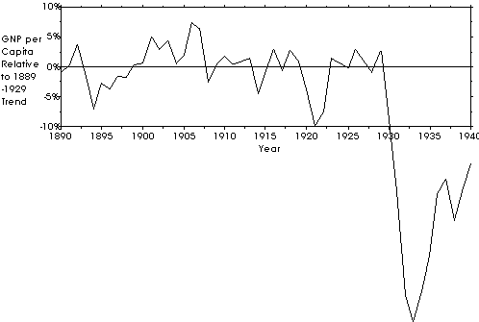
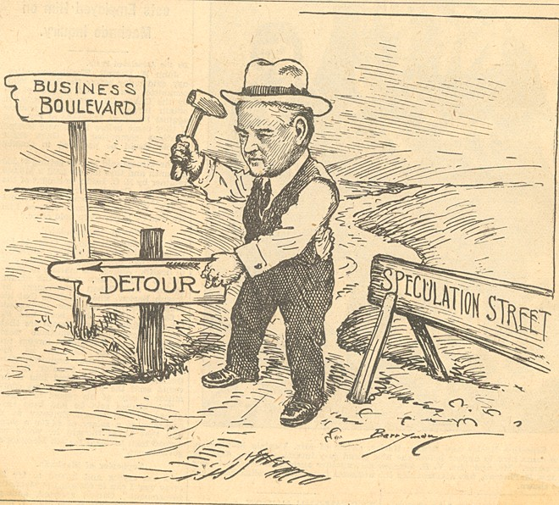
Beginnings of the Great Depression
Effects
Income levels dropped by half from 1929-1932
Housing construction down by over 80%
25% unemployment
Stock Market
2-3% of Americans owned stock
Symptom/cause of the Great Depression
“The good times will never end”

Slide 6
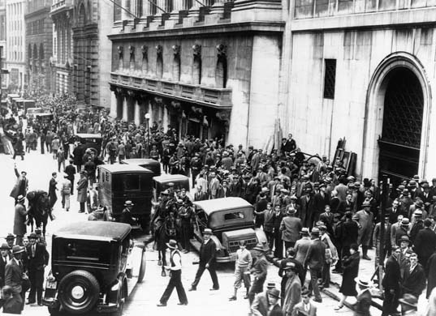

Slide 7
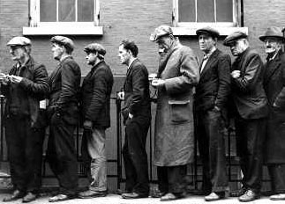
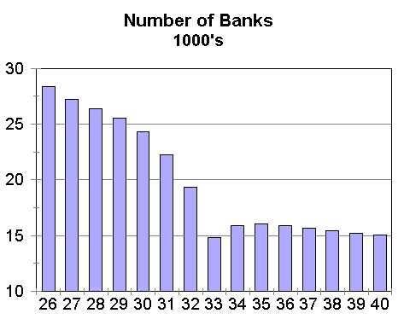
Signs that there was a depression
9000 banks close or go bankrupt
9 million accounts lost
Tight money supply by a 1/3
1931 Interests rates raised…YIKES!
1932 25% -13 million unemployment. mostly single income families.
Total wages down 12 bill to 7 bill 1929-1932

Slide 8
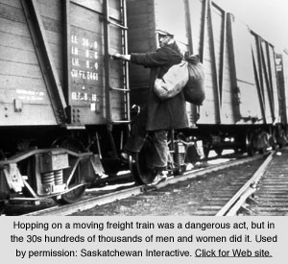
Signs that there was a depression
Unemployment in cities accentuated, Cleveland 50%, Toledo 80%, Akron 60%
4 mill men hit the rails “riding”. Freight trains, Hobos, 2 million move west looking for a new life (Grapes of Wrath), people begging.

Slide 9
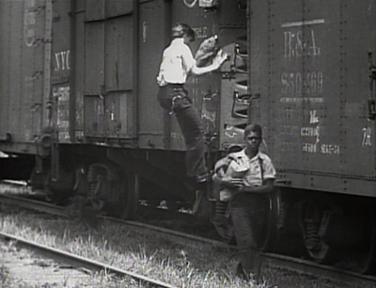
The teenagers riding the rails during the Great Depression accounted for 1/16 (250,000) of a jobless army that numbered four million. These itinerants crisscrossed the U.S. on the Pennsylvania, Atchison, Great Northern, Union Pacific, and Southern Pacific railroads, as well as other vast rail networks. In 1932, Southern Pacific agents ejected 683,457 trespassers from the company's trains. The price of trespassing on the rails was high: The Interstate Commerce Commission recorded 5,962 trespassers killed and injured in the first 10 months of 1932.

Slide 10
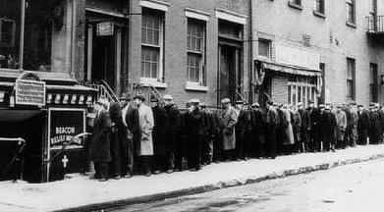
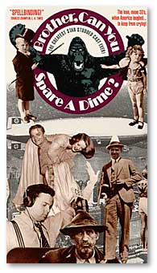
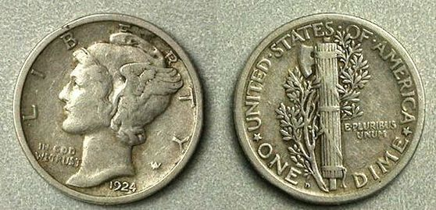
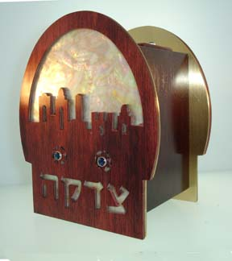
Brother can you Spare a Dime
"Brother, Can You Spare a Dime," lyrics by Yip Harburg, music by Jay Gorney (1931) Sung by Al Jolson
They used to tell me I was building a dream, and so I followed the mob,
When there was earth to plow, or guns to bear, I was always there right on the job.
They used to tell me I was building a dream, with peace and glory ahead,
Why should I be standing in line, just waiting for bread?
Once I built a railroad, I made it run, made it race against time.
Once I built a railroad; now it's done. Brother, can you spare a dime?
Once I built a tower, up to the sun, brick, and mortar, and lime;
Once I built a tower, now it's done. Brother, can you spare a dime?
Once in khaki suits, gee we looked swell,
Full of that Yankee Doodly Dum,
Half a million boots went slogging through Hell,
And I was the kid with the drum!
Say, don't you remember, they called me Al; it was Al all the time.
Why don't you remember, I'm your pal? Buddy, can you spare a dime?

Slide 11
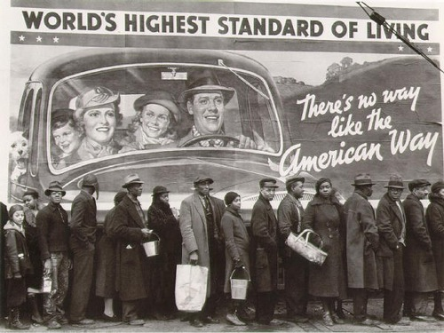

Slide 12
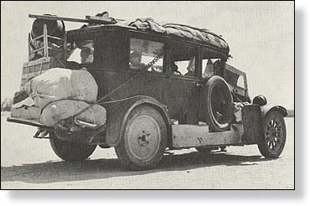
Signs that there was a depression
Bread lines, soup kitchens, 1/3 farmers lost land to auctions and bankruptcies-400,000
Suicides up, insanity up, 2600 schools close, children run away, blame themselves 2-4 mill, 60% children malnourished
Selling of family items, rings, jewelry, mattresses,

Slide 13
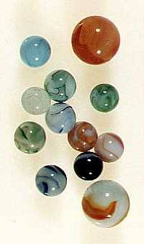
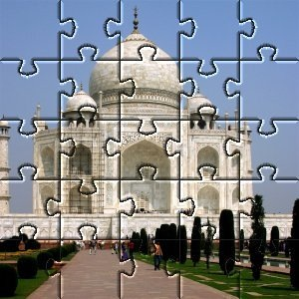
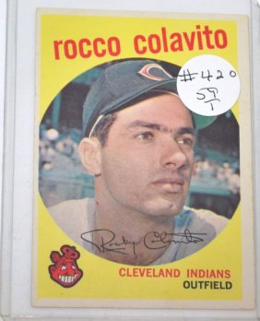
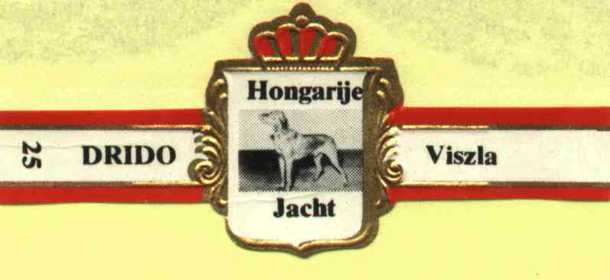
Odd items of the Great Depression
Over production of food, mass starvation
Less crime, as an understanding of others just like me
Saving everything “rat packers”, pencils, paper clips, tin foil, rubber bands
Items that take a lot of time were very popular, movies, jigsaw puzzles, marbles, collections of things like cigar rappers, baseball cards, anything marathons
Deflation occurs
Mattresses, cookie jars, walls
Hand me downs, darning clothes

Slide 14
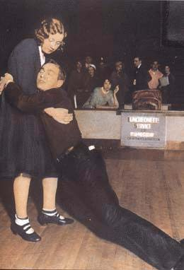
Living during the Great Depression. Just holding on.

Slide 15
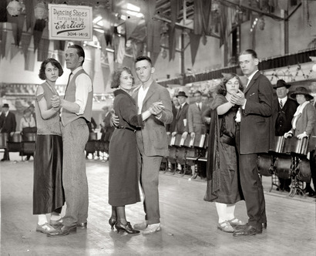

Slide 16
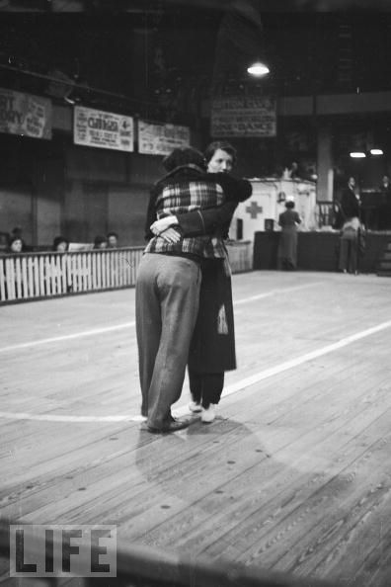

Slide 17
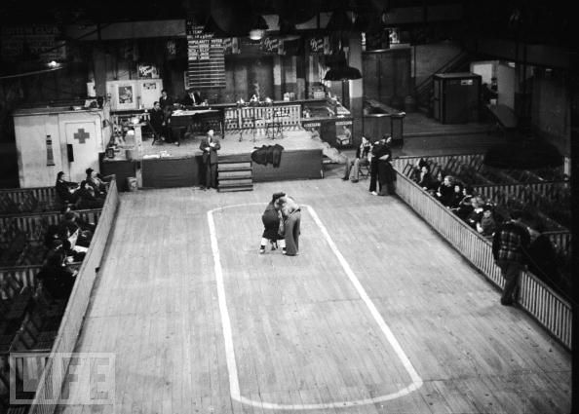

Slide 18
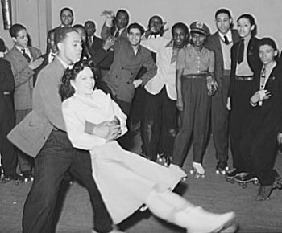

Slide 19
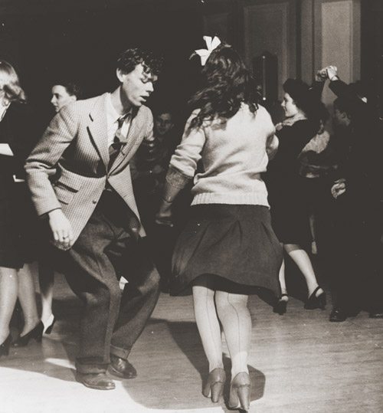

Slide 20
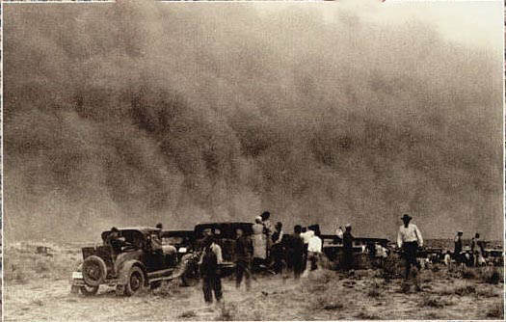
The Dust Bowl
1931-1937
Great plains of America
Climate created drought
Poor farming methods
½ will move to Cali, Oreg or Wash.
http://www.youtube.com/watch?v=KEYb9xjAhHI&feature=related

Slide 21
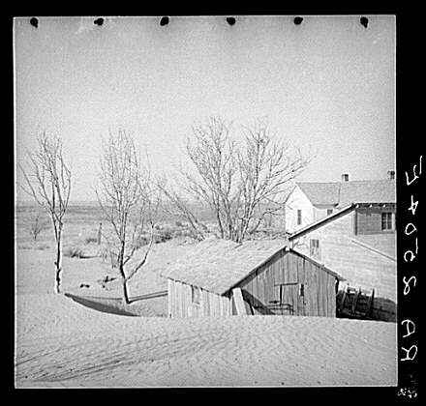
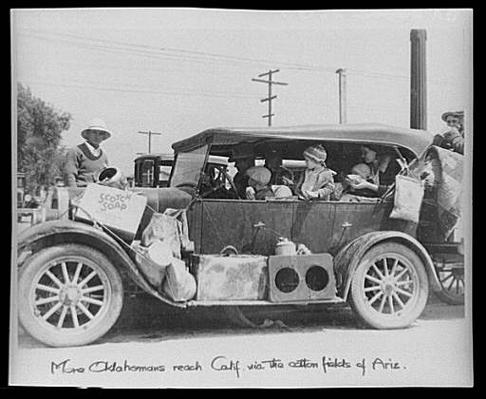
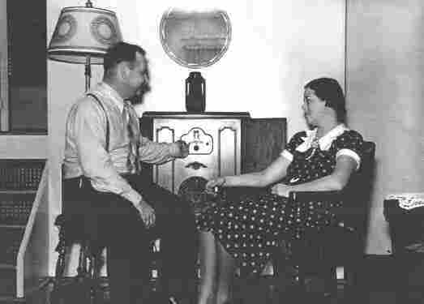
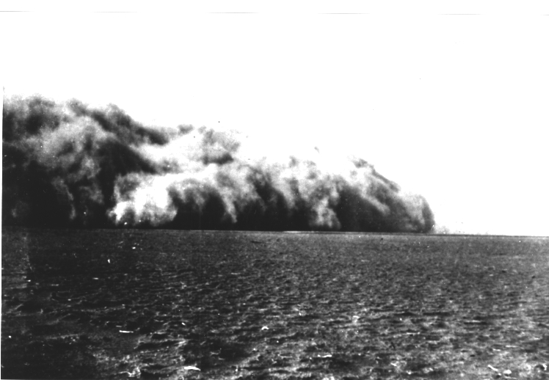
Gone with the wind
Family farmers fell victim to large, corporate farms seizing their land.
Before the time of government directed agricultural policies.
Agriculture had adopted many new scientific techniques allowing for extensive farming of already over-cultivated land.
FDR limits grazing on public lands.

Slide 22
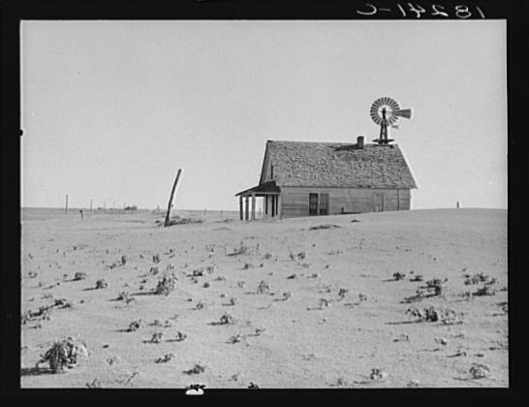

Slide 23
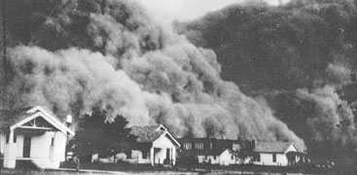
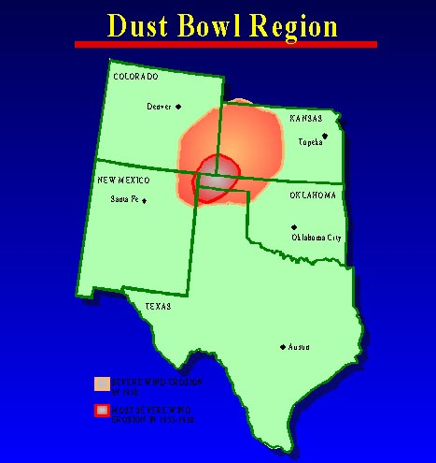
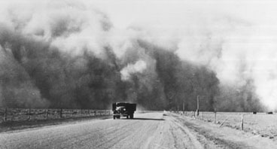
The Dust Bowl

Slide 24
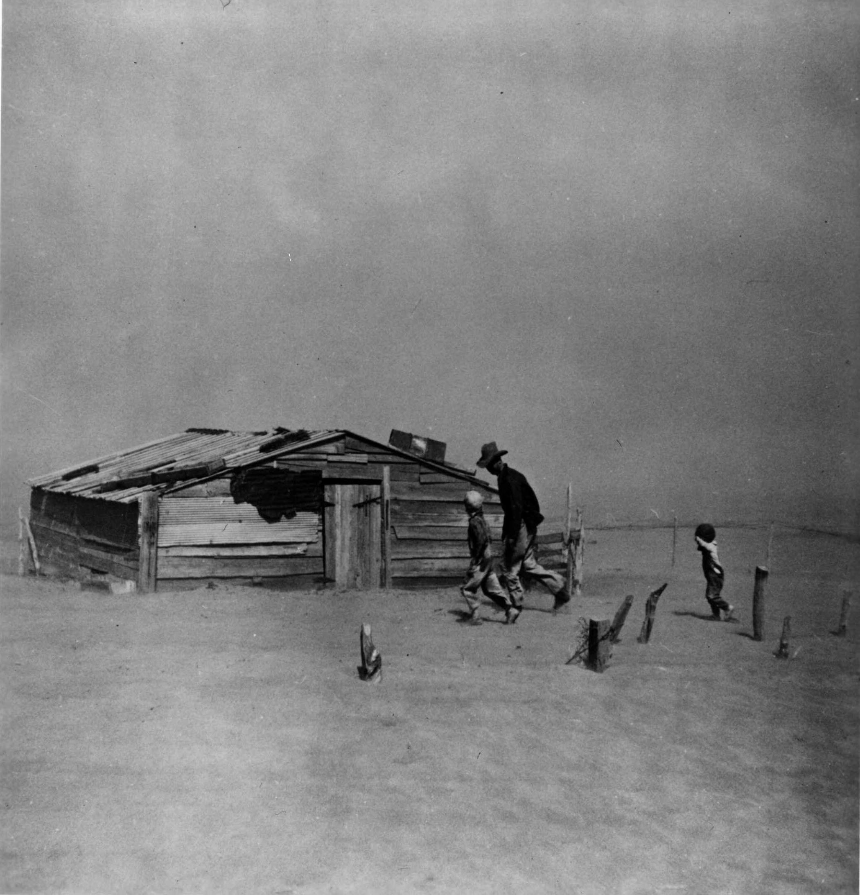
The Dust Bowl

Slide 25
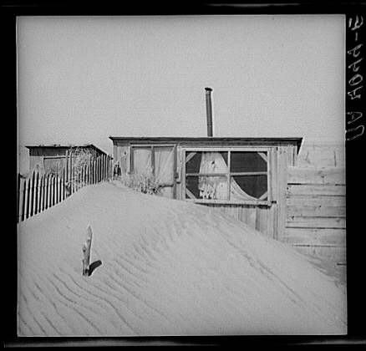

Slide 26
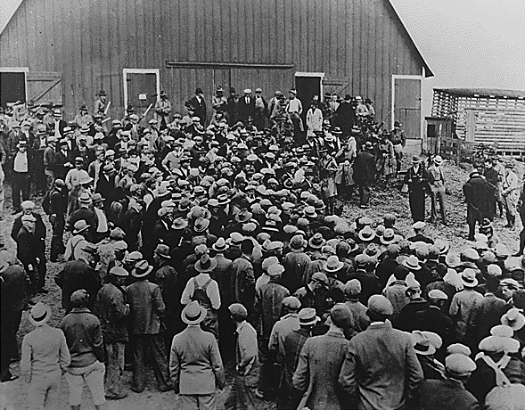
The basement collapses
Farmers
Mortgage foreclosures/penny auctions
Milk dumpings/Farmers Holiday Assoc. (strike)
Stock market crash irrelevant
Already trying to just drain the swamp
Urban folks
Hunger was rampant

Slide 27
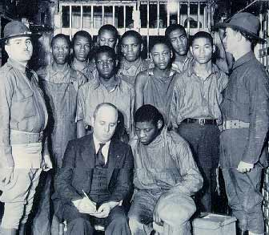
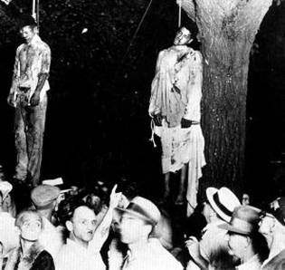
Africans Americans and the Depression
½ blacks still live in the south, but migration North still occurring. (2nd great Migration) Illinois Central RR
Depression hurts blacks more than whites, “Last hired first fired.”- by 1932 ½ unemployed
No gov’t relief, approx 400,000 leave the south and go north
In March 1931, nine young black males, aged 13 to 21, riding in an open freight car through rural Alabama were jailed and put on trial after being accused of raping two white women -- Ruby Bates and Victoria Price -- who also were aboard the train.
Scottsboro 9, 1931 taken off train and arrested for vagrancy, later two white women said they were raped. Evidence to contrary, convicted, 8 to death penalty
NAACP comes to defend along with communist party
Supreme court eventually overturned, 1932 New cases, 8 get freedom, 4 charges dropped, 3 paroled, one escaped, one served until 1950.
Still law was not blind, Song Strange Fruit

Slide 28
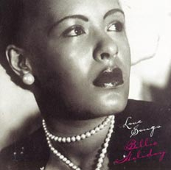
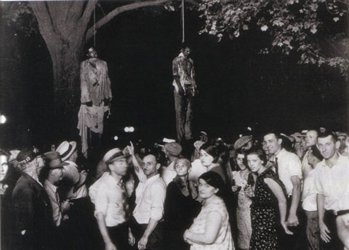
S t r a n g e f r u i t
Billie Holiday
http://www.youtube.com/watch?v=o1ky_w8NS_Q&feature=related
Southern trees bear strange fruit, Blood on the leaves and blood at the root, Black bodies swinging in the southern breeze, Strange fruit hanging from the poplar trees. Pastoral scene of the gallant south, The bulging eyes and the twisted mouth, Scent of magnolias, sweet and fresh, Then the sudden smell of burning flesh. Here is a fruit for the crows to pluck, For the rain to gather, for the wind to suck, For the sun to rot, for the trees to drop, Here is a strange and bitter crop.
"Strange Fruit" began as a poem about the lynching of a black man written by a Jewish schoolteacher from the Bronx Abel Meeropol, who used the pen name Lewis Allan (the names of his two children, who died in infancy). Meeropol and his wife were also the adoptive parents of the children of the executed spies Ethel and Julius Rosenberg in the 1950s."Strange Fruit" was written as a poem expressing his horror at the lynching's and was first published in 1937.

Slide 29
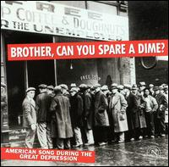
Depression Families and values
Women in conflict with home and making ends meet, effected them more
Women groups all but disappear during depression
Preserves become very popular, sewing, darning clothes, hand me downs, second hand, home businesses, bake sales, laundry service, accepting boarders, extended families become the norm.
Divorce expensive, men leave to find jobs, abandon family, children feel like burden. “No Promises in the wind.”
Birth rates and marriages decline
I’m to blame for not having a job
Single period in American history where more people leave then immigrate USA, 130,000 go to USSR alone.
Dale Carnegie new self help business, 1936. How to win friends, influence people.
“Brother Can you spare a dime”

Slide 30
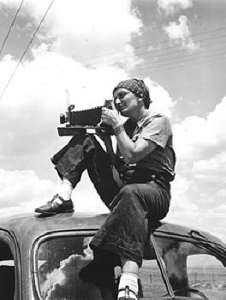
Artist and Intellects
Photography was brought to the forefront of art by the Government of FDR who wanted to document the great depression in all regions and areas of the country.
Documenting the time period was the most popular artist style of the great depression in all mediums.
Dorthea Lange was the most famous photographer
Others include Roy Stryker, Walker Evans, Ben Shahn and Margaret Bourke-White

Slide 31
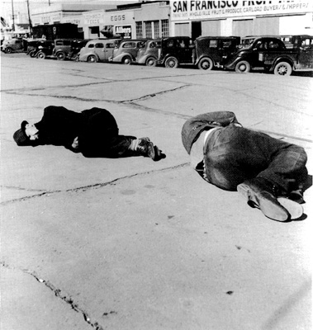
Photography
http://www.youtube.com/watch?v=nHVtZzJ3djg

Slide 32
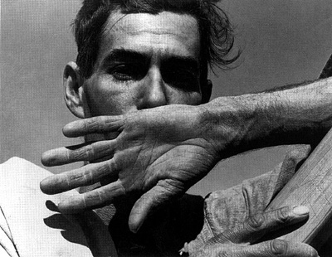
Photography

Slide 33
Photography

Slide 34

Photography

Slide 35

Photography

Slide 36



Writers of the Great Depression
Documented the solitude of people and their lives.
Writers like John Steinbeck: Grapes of Wrath, Tortilla Flat, Of Mice and Men, East of Eden

Slide 37

Painters of the Great Depression
Painters also documented the solitude of life in America.
Edward Hopper and Thomas Hart Benton were two examples. (Hopper’s Night Hawks)

Slide 38

Edward Hopper

Slide 39


Slide 40


Slide 41


Slide 42


Slide 43

Thomas Hart Benton's The Sources of Country Music portrays 17 nearly life-sized figures and illustrates the various cultural influences on country music, including a train, a steamboat, a black banjo player, country fiddlers and dulcimer players, hymn singers and square dancers. The painting memorializes entertainer Tex Ritter as the singing cowboy on the right. Image provided by The Country Music Foundation

Slide 44



Thomas Hart Benton

Slide 45

Thomas Hart Benton
Thomas Hart Benton: The Ballad of the Jealous Lover of Lone Green Valley, 1934.

Slide 46


Slide 47







Radio
Most people owned one, last thing they would pawn.
Soap operas and comedic events were the boss
Amos and Andy, Super man, Dick Tracy, Lone Ranger, The Shadow, the stories which were sponsored by soap companies
Fire side chats
CBS, NBC, ABC, concerts, music, sporting events and tragedies like the Hindenburg
Orson Wells 1938 broadcast of the War of the Worlds
Gave Americans a Common Experience, similar culture, Cheap entertainment, that lasted a long time……similar to Jig Saw Puzzles.

Slide 48


Movies
6 hours in a day for 10 cents, great bargain, escape the Great Depression
John Ford, Frank Capra, Marx Brothers, Walt Disney Steam Boat Willie and 1937 Snow White
http://www.youtube.com/watch?v=YUZ1hjn_9Ds

Slide 49

Slang of the 1930’s Match up the terms to the meaning
Alligator
Spinach
With bells on
Hoover blanket
Have kittens
G-man
Cut a rug
Buttinski
Boon doggle
Scuttlebutt
Shangri La
Threads
Dilly
grease
Nervous Nellie
High hat
Sad sack
Back burner
unpopular person
Rumor
difficult
to bribe
nonsense
arrogant or superior
project wasting public funds
anxious person
to dance
Clothing
definitely
to get excited
to postpone
FBI agent
a fan of swing/jive music
paradise
newspaper
a nosey person

Slide 50

The exploitation of the Worker
Socialist and communists ideas became popular in literature.
Grapes of wrath by Steinbeck and many Thomas Hart Benton paintings showed this theme.
Americans did not support these themes.
Abraham Lincoln Brigade goes to Spain to Fight against Franco’s Fascists.
Germany and Italy become fascists too.

Slide 51


Hoover
Hoover was not responsible for the Great Depression. However, his policies and laissez-faire approach probably hindered his ability to confront an unprecedented economic holocaust. His emphasis was on voluntary action- rugged individualism.
Politically speaking, Hoover would suffer the wrath of the American people. His political instincts did not serve him well. He failed to realize the magnitude of events and the changing dynamics of international economics. In essence, Hoover was caught in an economic time-warp of his, and many others, own making.
During the Great Depression preceding the passage of the Social Security Act under FDR, "soup kitchens" provided the only meals some unemployed Americans had. This particular soup kitchen was sponsored by the Chicago gangster Al Capone.

Slide 52

Hoover’s conservative policies
Voluntary cooperation action by businesses- few volunteered not to cut wages or reduce production
Rugged individualism
Pushed for deficit spending but it was not enough, but in 1932 proposed tax increases as a balanced budget was needed he believed.
Gold standard
Trickle down theory v. Pump priming
Hoover blames foreign economic policies
Hoover as lightening rod
Hoovervilles
Political “tin ear”

Slide 53


Slide 54


Hoover’s call to action
Agricultural Marketing Act of 1929
Co-ops- Loans
Price floors
Foreclosures/spiraling collapse of farm prices, thus income
Inadequate appropriations
Hawley Smoot Tariff Act 1930
Protective act created a wall around American Economy, Highest Tariff ever- 60%
State of denial
Simply an cyclical economic downturn
Hoover tax cut; affected few people

Slide 55

Hoover’s call to action Part 2
Supply-side or trickle-down economics- Pass of to big business
Reconstruction Finance Corporation-1931
Bailout of banks, insurance companies, railroads and mortgage companies; the lending institutions
Fails to understand demand-side policies
Federal Home Loan Bank Act; mortgages
Glass-Steagall Act
More loans to businesses
The common man did not appreciate this top down approach as they never saw the $ benefits.

Slide 56


Slide 57

Hoover; Same song, Second verse
No new farm legislation
Loans, not subsidies
Directed toward businesses, not individuals
Further debt would lead to more foreclosures
Direct Relief
Charities
State governments
Federal government had no role- Vetoes assistance

Slide 58


Slide 59

Bonus Army; Hoover digs his political grave
W.W.I veterans
Bonus($1000) due in 1945; seek early payment
March on Washington/Bonus City-1932, 20000
Defeat of bonus bill by Senate
Red flag of radical subversives
Veterans, wives and children
General Douglas MacArthur, Patton, Eisenhower, J. Edgar Hoover
Political realities
Hoover; Bonus Army, Hoovervilles, the people
Shacks, put up by the Bonus Army on the Anacostia flats, Washington, D.C., burning after the battle with the military. The Capitol in the background. 1932.

Slide 60

Hooverism
Hoover Shoes
Hoover sandwich
Hoover blanket
Hoover soup
Hoovervilles
Hoover flags
Hoover flush
Hoover Hogs
Hoover Cars

Slide 61
Themes For DBQ Essay Test
Themes For DBQ
1. Though often characterized as an era of groundbreaking, ‘progressive’ change, the 1920’s actually witnessed more intolerance and conservatism than substantive social advancement
2. Assess the relative influence of THREE of the following in the American decision to declare war on Germany in 1917.
German Naval policy
American economic interests
Woodrow Wilson’s idealism
Allied Propaganda
American claim to world power
3. Compare and contrast two of the three reform eras in terms of significance to American government, culture and economics.
Populism: 1890’s
Progressivism: 1900-1920
New Deal: 1933-1938
4. The New Deal was a revolution that dramatically changed how the American Federal Government would interact with the people.

Slide 62


Franklin Delano Roosevelt; The Second Coming of the Messiah?...no
Election of 1932: 57%-39%
FDR; progressive N.Y. governor
Old-age pensions
Cheap electricity
Relief programs
Presidential campaign- “Nothing to fear but fear itself”
Promised Americans, “New Deal”
Attacked concentrated wealth
Balanced budget/gold standard
Little specific ideas or programs
He was not Hoover-both houses-lame duck
“Vote for FDR and make it unanimous.”
http://www.youtube.com/watch?v=oblTN1ojsAA

Slide 63



FDR
FDR D for Democrat and C for Christian, Wilsonian in foreign affairs
Gentleman, well liked popular, charming, used radio in fireside chats, pragmatic politician
FDR believed initially that he would be able to work with the business community to cooperatively solve the nation’s problems.
FDR believed that the capitalistic system was sound, it simply needed the refinement of a “welfare state.”
FDR was seeking to supplement the system with a sense of economic justice.

Slide 64

Overview of the New Deal
Three phases
1933-1935; Relief/some Recovery
Direct relief
Aid to businesses, farmers, working folks
Massive government spending/economic planning
1935 and 1936; Recovery/some reform
Public works programs
Social Security
1937 and 1938; Reform
Long-term measures

Slide 65


FDR; the 1932 election and his “Brain Trust”
FDR offered very few specifics during his campaign as what he would do to solve the nation’s economic situation. Hence New Deal was vague (from Cousin’s square deal)
FDR assembled some of the brightest minds of the nation to serve in his official Cabinet and his inner-circle of advisors- Frances Perkins, Harry Hopkins, Harold Ickes.
“Try something, try anything. If it doesn’t work, then by God, try something else.” But for the nation’s sake, just try anything. Alphabet Soup
New style of leadership, first time president introduced legislative action.

Slide 66

The First Hundred Days
Bank Holiday- Close All Banks- stop bank “run-ons.” Part of Emergency Banking Act-1933 Off Gold Standard
Glass Steagall Act 1933 - created banking regulations
FDIC- $2500-$5000
Banker Act of 1935- Fed’s, 7 member, 14years began in 1913 under Wilson
Securities Act in 1933- Stock Market regulation- SEC-1934
Speculative/margin buying
Legitimacy of stock transactions
Repeal of Prohibition End 18th push for passage of 21st.

Slide 67


FDR: inflation and the money supply
Congress gave FDR almost unlimited power to manipulate the value of the dollar
Inflationary policies advocated
Increase of the money supply- $1 Bill in notes
Debtors, especially farmers, would see prices rise, therefore putting more money in the hands of consumers
FDR removes the U.S. dollar from the Gold standard

Slide 68


Civilian Conservation Corps
Geared to employ young men on conservation projects.($25)
Money directed toward their families
Removed young men from the private sector job market
Helped older workers from competition from younger workers who would work for less
Increased consumer buying power
Women not beneficiaries of the program

Slide 69

Civilian Conservation Corps

Slide 70


Relief Measures
Federal Emergency Relief Administration(1933-1935)
Direct grants to cities and states to provide direct relief to the unemployed
Home Owners Lending Corporation-(HOLC)
1 mill homes- FHA
Civil Works Administration (CWA); 33-34
Employed folks to build public works projects
Schools, roads, bridges, airports, teachers for rural areas- Transformed to WPA
Pump priming-John Keynes
Demand side economics
Stimulating consumer buying power

Slide 71

Public Works Administration
Continuation of economic stimulation of consumer buying power just as CWA had done. Lasted from 1933-1939 but more extensive than CWA-Hoover Dam
Neither program increased consumer buying power significantly but rather served as measures to stop a further drastic decline in buying power.

Slide 72

Agricultural Adjustment Act
Farmers, already suffering for over a decade, were desperate for change.
Emergency Farm Mortgage Act
Prevent more farm foreclosures
Agricultural Adjustment Act (AAA) 1933
Overproduction- regulate
Parity – Price up 50%
Acreage set-asides- created subsidies
Role of government in limiting production- controversial
*Supreme court would later find it unconstitutional, adopted in a state form Butler vs. U.S.
Rural Electrification Administration (1935)
http://www.youtube.com/watch?v=e09Hry-fbtQ

Slide 73

Almost one-half of American farmers were tenant farmers
Resettlement Administration
Attempted to relocate tenant farmers to land purchased by the government to enable them to buy and farm their own land
Poorly funded and limited success
Soil Conservation Corp
REA; 1935
Electric co-ops/LBJ and Sam Rayburn
1/10th had electricity in1936
Agricultural Adjustment Act

Slide 74

“What the government can’t do, then by God the weather will do it.”
Prices for some farm products raised a bit
Tenant farmers/sharecroppers-not so much
AAA ordered pass-on from large land holders to them, but more often than not, these pass-ons never took place
Large, commercial operations (corporate farms) simply increased production on less acreage, violating the intent of the rules
Drought
Eliminated overproduction/raised prices

Slide 75

Minorities, the Great Depression and the New Deal
Collapse of the South’s cotton industry instigated further migration of southern blacks to northern cities. (Boll Weevil)
New Deal programs discriminated against blacks, sometimes intentionally, sometimes unintentionally
segregation
AAA disproportional affect on black sharecroppers
Jacob Lawrence, The Migration of the Negro
Welcome to "One Way Ticket: The Great Migration North". "One Way Ticket" refers to a Langston Hughes poem of the same title. The poem expresses the longing that many southern African Americans felt, to move to the northern United States, to what many thought was the "promised land". This massive migration numbered was the largest internal migration in history, and took place from about 1890 to the 1970's.

Slide 76

FDR; minorities and political realities
Many southern congressman controlled committee chairmanships
Segregation was a political reality in the South
New Deal programs would have failed without southern congressional support
FDR would not support a federal anti-lynching bill or one repealing the poll tax
FDR/”Black Cabinet”; progressive for the time
Eleanor Roosevelt

Slide 77

Industrial Recovery; “what business messes up, government cleans up”
National Industrial Recovery Administration- NIRA (1933)
National Recovery Administration (NRA)-1933
Antitrust policies waived
Cooperation and competition codes set
Stabilize prices and wages
National Labor Board
Collective bargaining and organizing rights for labor
NLB dominated by business interests
Concerns about monopoly and effect on small businesses
Supreme Court eventually finds Unconstitutional- Schechter Decision- Sick Chicken Case
Wagner Act (NLRA) 1935

Slide 78



“I remember when Muscle Shoals was just a swamp land”
Conservation
Flood control projects
Forests, wildlife and game programs
Jobs as motivation
Tennessee Valley Authority-1933
Cheap electricity, flood control, fertilizer
Massive regional development
Intensive job creation
Opposed by private utility companies
All of these examples of FDR liberalism- NO free hand outs, no money, people had to work, usually manual labor, hard days labor, kept pride in the man with work
TVA built dams to harness the region’s rivers. The dams controlled floods, improved navigation, and generated electricity.

Slide 79

Nearing the end of the first New Deal
Production and stock market improve slightly
Business and Corporate interests
Socialism; govt. economic planning
Gold standard
Work relief programs
Liberty League
1934 mid-term elections
Considered his presidency the Broker state, negotiator

Slide 80

Swinging from the Left Field Bleachers
The American Liberty League – from the Right
Upton Sinclair
Old age pension fund
Higher income/inheritance taxes
Francis Townsend- California
Old age pension fund
Money must be spent
Father Charles Coughlin-Royal Oak, MI
FDR too pro-business
Attacked the “Jewish banking cartel”
Charles Coughlin, the radio priest of Detroit, gave his 1st radio sermon Oct. 26, 1925, on WJR, and used radio to raise money to build his Shrine of the Little Flower Church in Royal Oak MI. His radio show was cancelled by CBS in April 1931, but he formed his own network of 35 stations. He was pro-FDR until 1934 when he organized the National Union for Social Justice to oppose FDR and Henry Morgenthau, praised Huey Long and Mussolini. By 1938 he was allied with the German-American Bund in a Christian Front against Jews, unions, communists. The new NAB code in 1939 caused radio stations to cancel Coughlin's broadcasts and he was off the air by April, 1940. In 1942 his newspaper was banned from the mails under the Espionage Act for being pro-Nazi and ceased publication.

Slide 81

Senator Huey P. Long; Thunder on the Left
“Share the Wealth”-$2500
Confiscate all income over a million dollars
Old age pensions
Expanded government programs
Roads and highways
Schools
Hospitals
Guaranteed education from K through College
Taxed the oil/refinery and corporate interests

Slide 82


Corporations and the Wealthy
FDR responds to the political influence of Senator Huey P. Long in 1935- "The Kingfish" as Robin Hood
Public Utility Holding Act. A public necessity required public control
Increased income taxes on the wealthy
“Let it be said in my first term that the forces of concentrated wealth met their match; in my second term, let it be said they met their master.” FDR

Slide 83

SECOND NEW DEAL 1935-1937
FDR realizes that the business community will not support his programs and begins to attack the interests of concentrated wealth. Also focus on Reform.
FDR is also responding to the political pressures from those who want him to do more. More specifically, he is feeling the political pressure of Huey P. Long.

Slide 84


Social Security Act: 1935
The U.S. was the last industrialized nation of the world to lack a universal plan for retirement, unemployment and health insurance.
Proposal
National health insurance
Old-age pension plan
Unemployment compensation fund
A middle-class welfare program
Payroll tax, ½ and ½, handicap, unemployment benefits dependent children. Safety net
Trying to encourage older people to retire, open up jobs for men with families.

Slide 85


Slide 86

FDR on taxes to pay for Social Security
“We put those payroll contributions there so as to give the contributors a legal, moral, and political right to collect their pensions and unemployment benefits.”
“With those taxes in there, no damn politician can ever scrap my social security program.”

Slide 87



Work Relief and Social Security
Wagner Act 1935-Corp not happy FDR saw the need to increase the power of the working class in order to increase their buying power to stimulate the economy. Unions provided the tool.
Outlawed black listing
Union organizing/collective bargaining
NLRB; certification of representative organizations/50% union increase in 2 years
WPA; 1935-1941
First massive attempt by federal government to solve unemployment, 8 million jobs, $11.4 bill budget 40%
Largest expenditure for a government program in U.S. history
Workers paid less than private industry
Massive number of public works projects-110000 buildings, schools, libraries, public buildings, Zoos and parks, sidewalks, manual labor, infrastructure, 600 airports, 100,000 bridges
One job per family; men first
Critics; “We piddle around”, competition with private contractors

Slide 88

WPA -Housing
National Housing Act; 1937
Slum clearance
Low-income housing
Home Owners Loan Corporation
Low interest loans
Long-term mortgages
Encourage suburban housing projects
Redlining

Slide 89

Housing
Federal Housing Administration (FHA)
Insured home mortgages in leiu of private insurance companies who refused to do so
Reduced down payments
Favored suburban homes
Fair Labor Standards Act
Raised minimum wage/ 40 hour week
Prohibited child labor
Affected interstate commerce only

Slide 90


Part of WPA
NYA- National Youth Administration
FAP-Federal Arts Projects
FTP, FWP, FMP, Cleminson Hall- Edgar Yaeger
Controversy: Six ideas
Grosse Pointe (South) High School Cleminson Hall

Slide 91



Slide 92




Slide 93






Slide 94




Slide 95


Slide 96


Slide 97


Slide 98


Slide 99


Slide 100

American Indians
Indian Reorganization Act of 1934
1st major change in governmental policy/
Encouraged preservation of Indian culture
John Collier; good intentions, misunderstanding of traditional Indian culture
political autonomy of tribes through democratically elected tribal councils
Replaced the traditional council of elders that Indians preferred.
Citizenship in 1924
Secretary of the Interior Harold Ickes, seated at the center, and John Collier, head of the Bureau of Indian Affairs, who developed the legislation.

Slide 101

Women
Major appointments to government posts by FDR
Francis Perkins; Secretary of Labor-1st female Cabinet member
New Deal programs reflected the traditional values of the time
A woman’s sphere was the home.
New Deal jobs went to men first and foremost
Women expected to give up jobs for men

Slide 102


New Deal in Disarray
Election of 1936
Landslide provides mandate for FDR/New Deal
Black Americans abandon Republican party
FDR’s Court Fight –Court Packing plan
Supreme Court and New Deal programs- FDR convinced conservative Supreme Court trying to Stop New Deal,
AAA- US v Butler in 1936
Judiciary Reorganization Bill-1937
Add 6 new members
Retirement age 70 years
Back fires- people think he is trying to take over 3rd branch.
Hurts FDR politically; emboldens New Deal critics
Court changes direction
1937 West Coast v Parrish
Upheld Wagner Act and Social Security
1938 mid year elections swing towards republicans
Next 4 years appointed 7 justices, 9 total
Economy begins to slide again.

Slide 103
New Deal Critics and Support
Critics:
Failure to cure
Bureaucracy Mushroomed- Larger Federal Government
State power fades
National Debt-
US becomes “handout” state -Welfare
Class conflict
Planned economy- TVA
FDR and S.C.
Dummy Congress
Farm issues -
Didn’t end the Depression, WWII
Support:
Saved Capitalism
Restore American gov’t, pride and faith
Relief saved cities and revolution
Reforms still exist today
Fairer distribution of income
Self-respect- No Hand outs
Middle of the road
Great American Conservative since Hamilton
The Ages of Reform:
Populism: 1890’s
Progressivism: 1900-1920
New Deal: 1933-1938
WAR

